Slide 1



Ad-Hoc Analysis
By : Hrutik K. Sarode
Data-Driven Analyst

Slide 2
Agenda
Introduction
Audit
Workflow
Summary
Primary goals

Slide 3

Introduction
Atliq Hardware (fictitious corporation) is one of the major computer hardware manufacturers in India, with a strong presence in other nations.
Nevertheless, the management did note that they do not have sufficient insights to make prompt, wise, and data-informed judgments.
Plan to expand the data analytics team by adding junior data analysts.
To assess candidates, Data analytics director, Tony Sharma plans to conduct a SQL challenge to evaluate both tech and soft skills.
The company seeks insights for 10 ad hoc requests.
3

Slide 4


Primary goals
Data-Driven Decision-Making

Slide 5
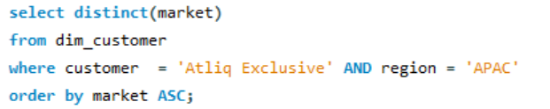
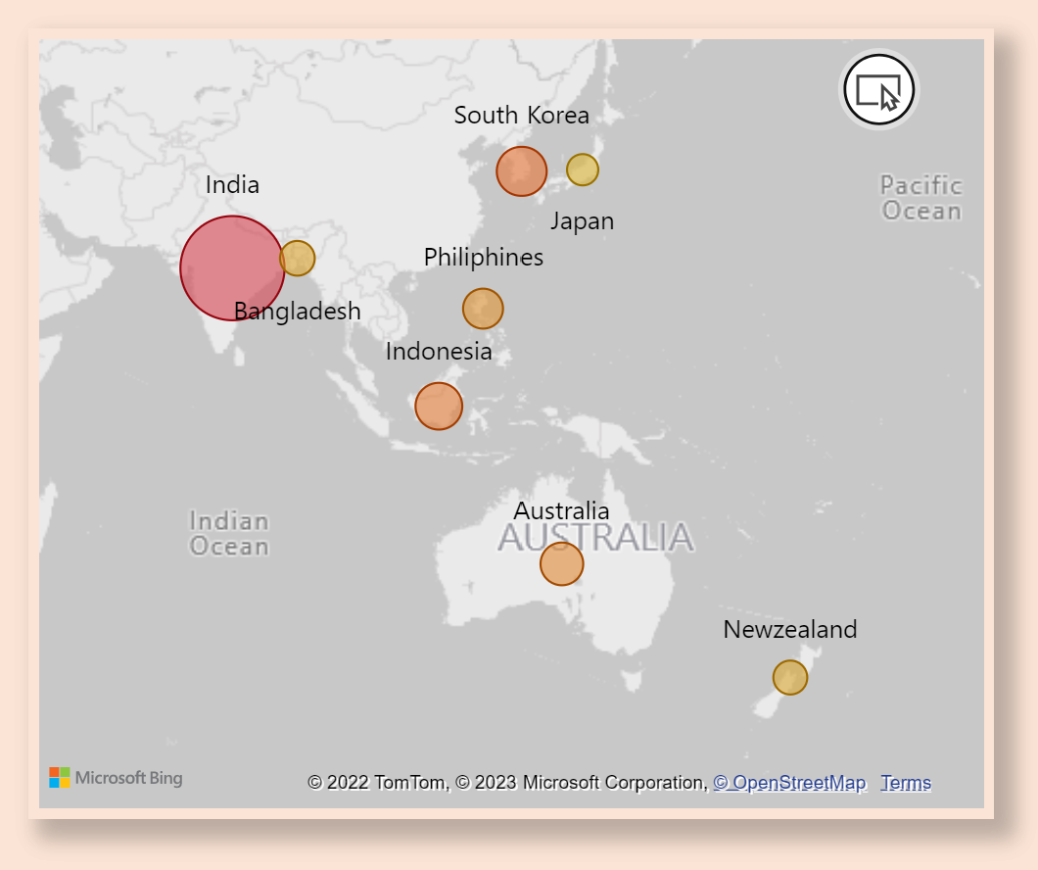
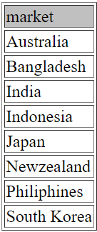
1. Provide the list of markets in which customer "Atliq Exclusive" operates its business in the APAC region.
India is a leading market in terms of Gross Sales for Atliq Exclusive in Asia Pacific region out of 8 countries, followed by South Korea, Indonesia, Australia and others.
5

Slide 6
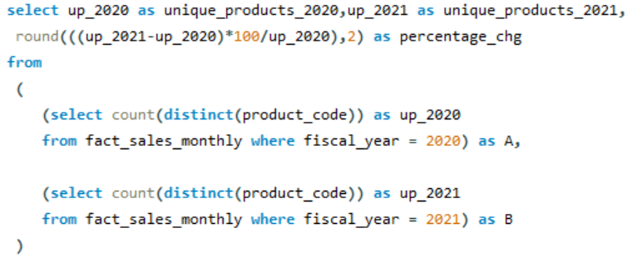
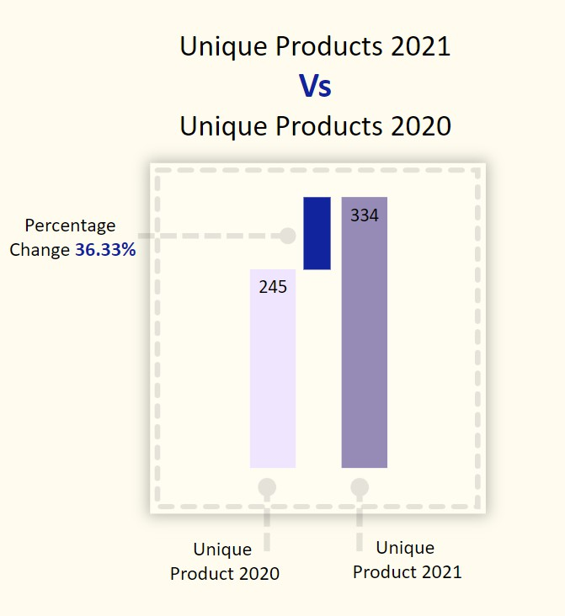
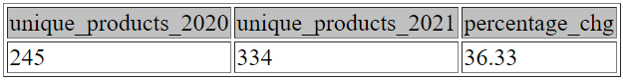
2. What is the percentage of unique product increase in 2021 vs. 2020? The final output contains these fields, unique_products_2020, unique_products_2021, percentage_chg
We observe a 36.33% rise in number of unique products from 2020 to 2021.
6

Slide 7
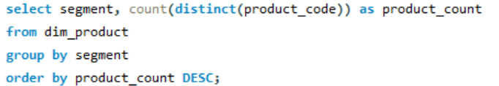
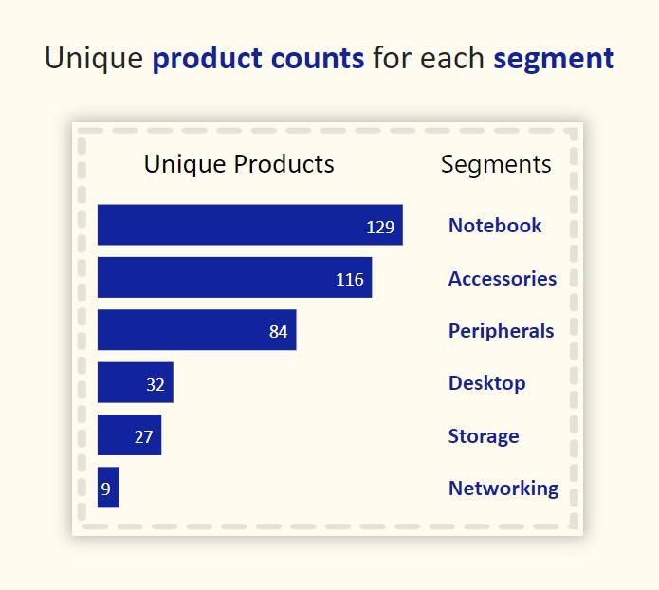
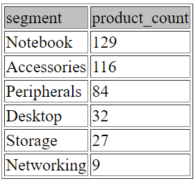
3.Provide a report with all the unique product counts for each segment and sort them in descending order of product counts. The final output contains 2 fields segment, product_count.
Atliq hardware can research on current trends as well as needs and introduce some new products in Networking and Storage segments.
7

Slide 8
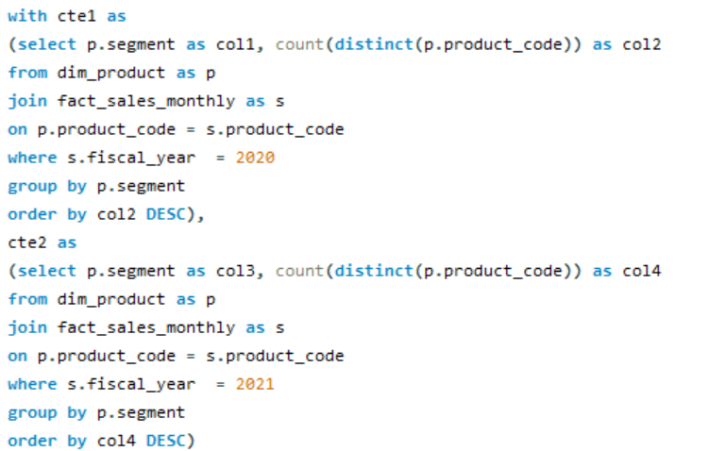
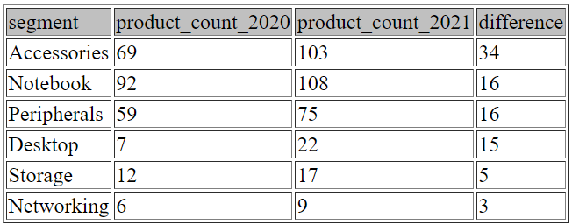
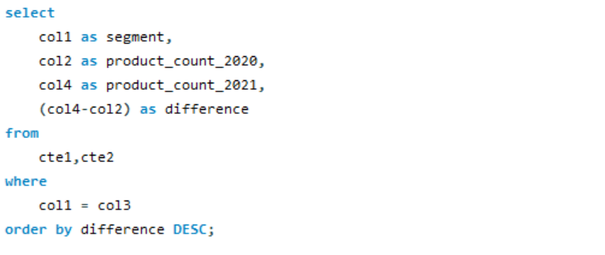
4. Follow-up: Which segment had the most increase in unique products in 2021 vs 2020? The final output contains these fields, segment product_count_2020, product_count_2021, difference.
For Atliq hardware, Desktop segment saw highest comparative increase in its products in year 2021.
8

Slide 9
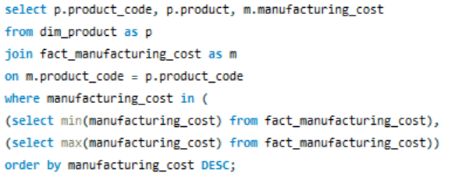
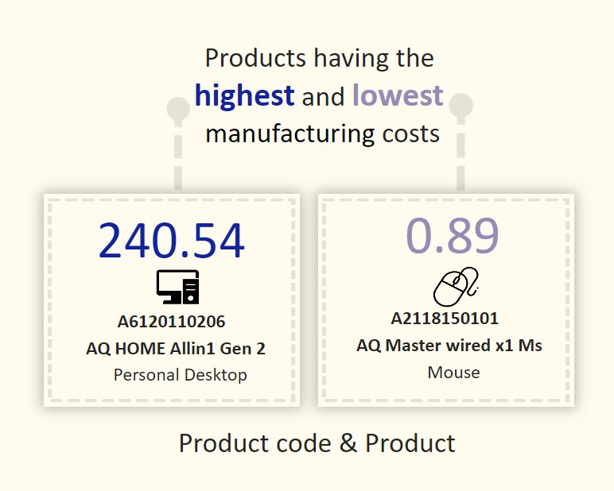
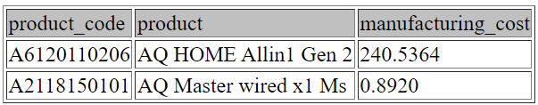
5. Get the products that have the highest and lowest manufacturing costs. The final output should contain these fields, product_code, product, manufacturing_cost.
Mouse: AQ Master wired x1 Ms (Variant: Standard 1) has the lowest manufacturing cost.
Personal Desktop: AQ Home Allin1 Gen2 (Variant: Plus 3) has the highest manufacturing cost.
9

Slide 10
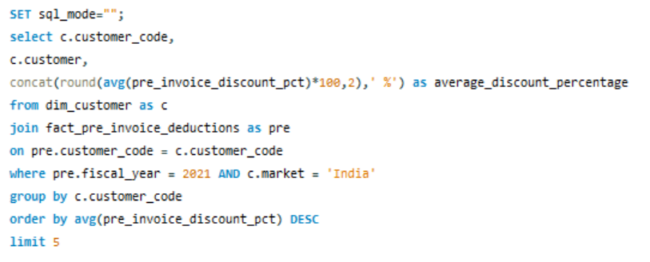
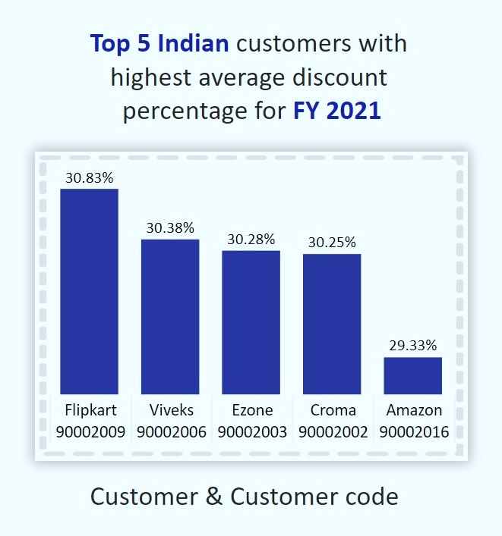
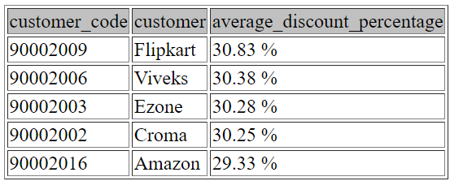
6. Generate a report which contains the top 5 customers who received an average high pre_invoice_discount_pct for the fiscal year 2021 and in the Indian market. The final output contains these fields, customer_code, customer, average_discount_percentage .
The largest average pre-invoice discount was given to Flipkart. The least average pre-invoice discount was given to Amazon.
10

Slide 11
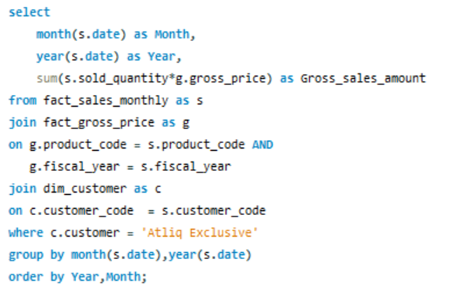
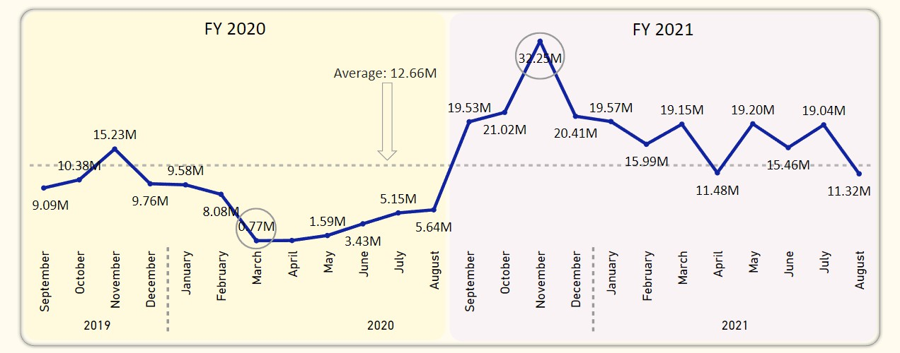
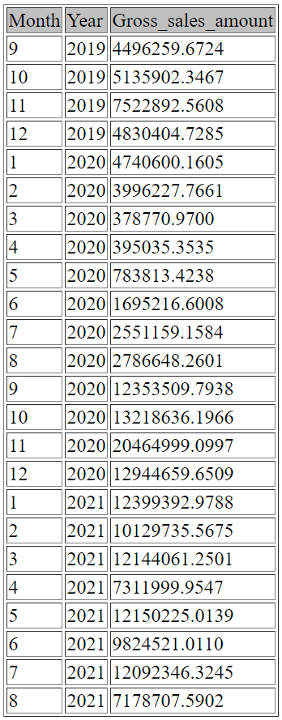
7. Get the complete report of the Gross sales amount for the customer “Atliq Exclusive” for each month. This analysis helps to get an idea of low and high-performing months and take strategic decisions. The final report contains these columns: Month, Year, Gross sales Amount.
73.8% of the total Gross sales figure is in FY 2021.
Atliq hardware can introduce some products to increase sales in summer. Overall the sales have increased after pandemic and have remained consistently high then pre pandemic year.
11

Slide 12
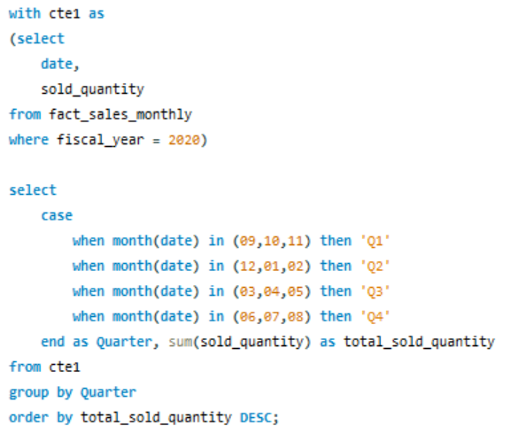
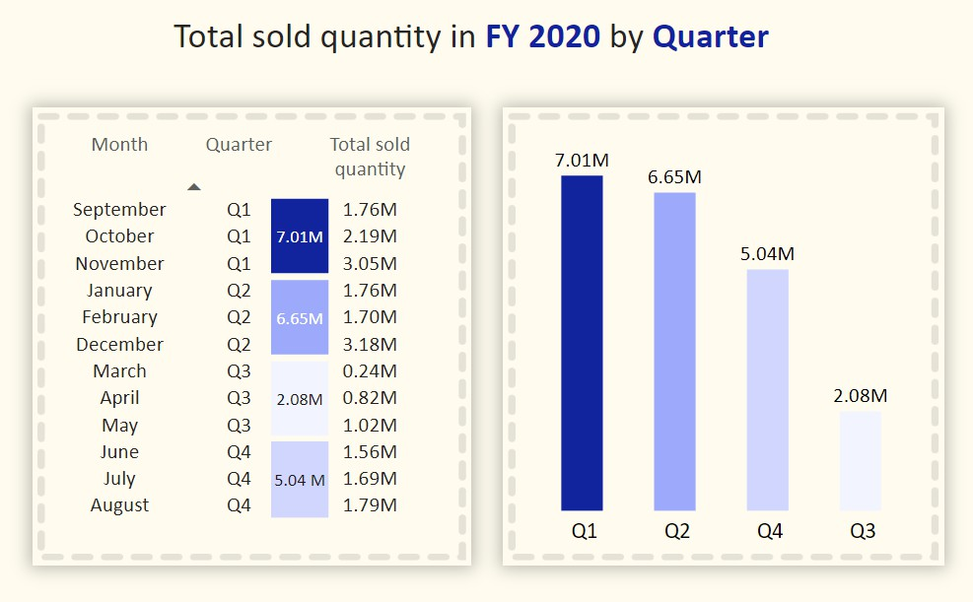

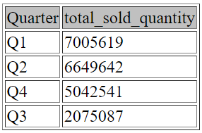
8. In which quarter of 2020, got the maximum total_sold_quantity? The final output contains these fields sorted by the total_sold_quantity, Quarter, total_sold_quantity.
Quarter 1 of FY2020 saw the most units sold overall, while Quarter 3 had the fewest.
The highest and lowest overall sold quantity is in December and March. Quarter 1 accounts for approximately 34% of the total sold quantity for FY2020.
12

Slide 13
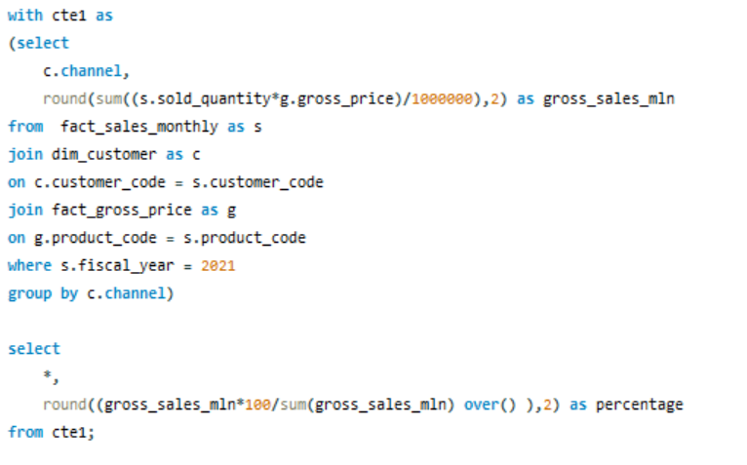
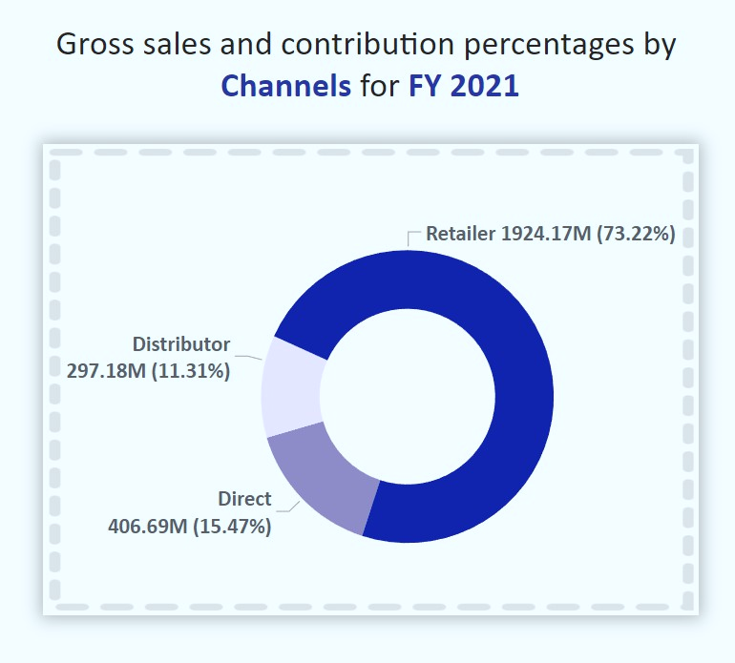
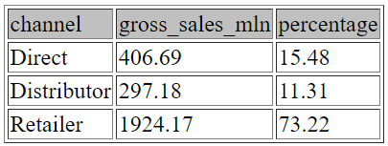
9. Which channel helped to bring more gross sales in the fiscal year 2021 and the percentage of contribution? The final output contains these fields, channel, gross_sales_mln, percentage.
Channel: "Retailer" helped bring maximum sales to the company with 73.22% as the contribution percentage.
Channel: "Distributor" makes the least contribution at a percentage of 11.31%.
13

Slide 14
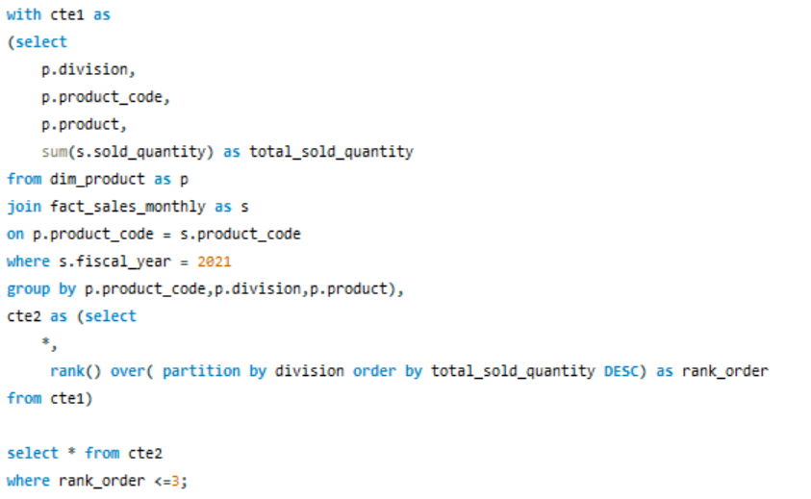
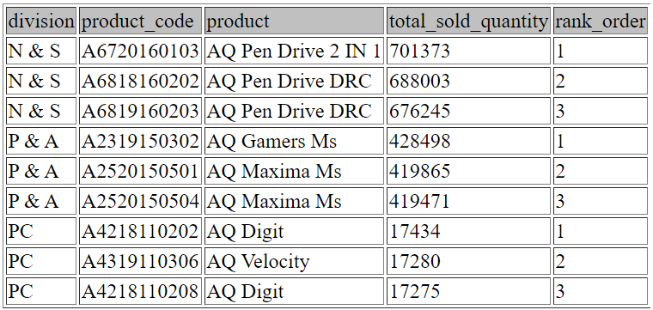
10. Get the Top 3 products in each division that have a high total_sold_quantity in the fiscal_year 2021? The final output contains these fields, division, product_code, product, total_sold_quantity, rank_order.
14

Slide 15
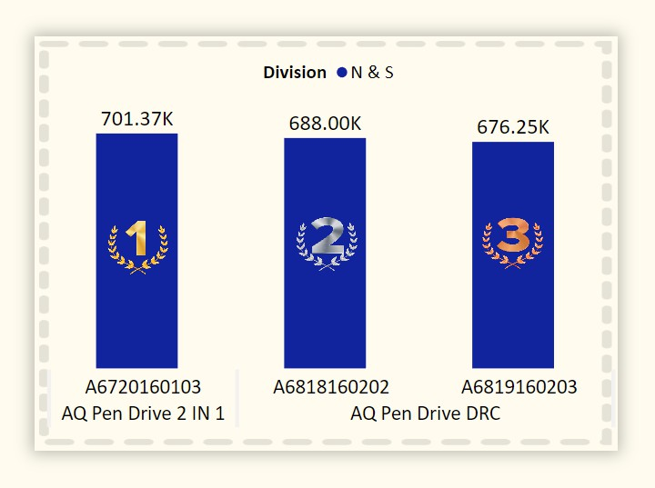
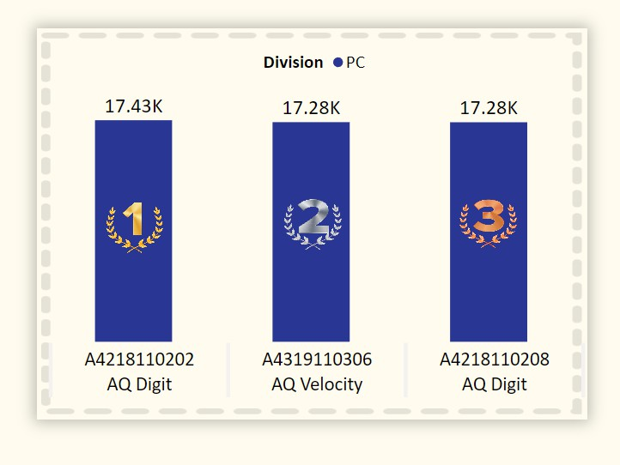
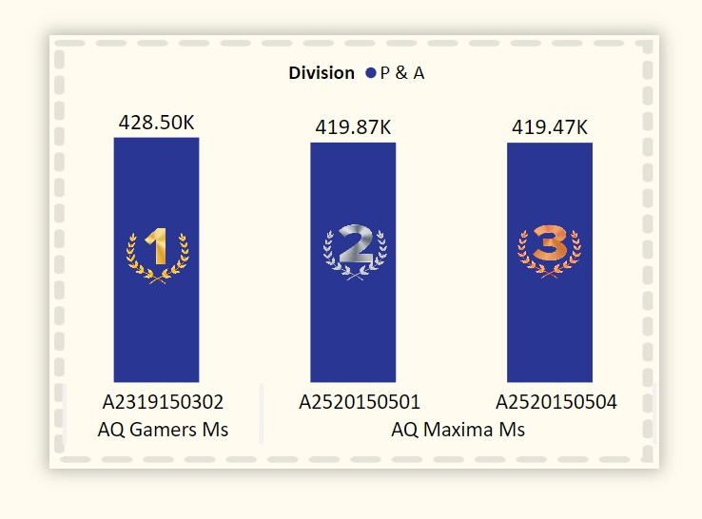
10. Get the Top 3 products in each division that have a high total_sold_quantity in the fiscal_year 2021? The final output contains these fields, division, product_code, product, total_sold_quantity, rank_order.
Every division has a product with different variants that appears twice in the top three products by division list.
15

Slide 16
Areas of growth
Global Market Expansion
Diversification of Product Line
Technological Advancements
Strategic Partnerships
Data Analytics Capabilities
Explore and enter new international markets to increase the company's global presence.
Introduce new and innovative computer hardware products to diversify the company's offerings.
Invest in research and development to stay at the forefront of technological advancements in the hardware industry.
Form strategic partnerships with other technology companies to enhance product development and market reach.
Continuously enhance and leverage data analytics capabilities for informed decision-making and improved operational efficiency.
16

Slide 17
Areas of focus
Talent Development
Data-Driven Decision Culture
Operational Efficiency
Customer Satisfaction
Innovation in Product Design
17

Slide 18



How we get there
Global Market Expansion
Conduct market research to identify promising international markets.
Adapt products and marketing strategies to meet the specific needs of diverse global markets.
Diversification of Product Line
Invest in research and development to identify gaps in the market.
Collaborate with product designers and engineers to create new and innovative hardware products.
Test and gather feedback from target markets during product development.
Data Analytics Capabilities
Invest in advanced analytics tools and technologies.
Provide training programs for employees to enhance data analytics skills.
18

Slide 19

Summary
Atliq Hardware has performed well in year 2021 introducing 102 new products with Peripherals and Accessories bringing in the highest revenue followed by PC.
PC is the strongest performing division, generating 39% of total sales while accounting for only 3% of overall quantities of products sold.
Try to tweak discounts rates such that the customers bring in more gross sales for the company.
Space to increase e-commerce sales by partnering with new e-commerce platforms with competitive discounts.
19

Slide 20




Thank you
Hrutik K. Sarode
hksarode14@gmail.com
LinkedIn GitHub

